Slide 1






TOUR GUIDE PROVIDING SERVICE
Presented by:
Tanmoy Mazumder 19101013
Ali Mostakim Alvi 19101015
Shawan Das 19101020
Presented To:
Shammi Akhtar
Assistant Professor
CSE, UAP

Slide 2

Contents
System Analyst
Information Gathering Tools
Requirements specification

Slide 3

System Analyst

Slide 4
System Analyst
Who is system analyst
The people/person who Performs Organizational role the most responsible for analysis and design of information systems

Slide 5
System Analyst
Roles and responsibilities of a system analyst
The analyst must be able to work with people of all descriptions and be experienced in working with computers.

Slide 6
System Analyst
What does a system analyst do
Change agent
Architect
Motivator

Slide 7
System Analyst
Qualities of a system analyst
Problem solver
Communicator
Strong personal and professional ethics
Self-disciplined and self-motivated

Slide 8

Information Gathering Tools

Slide 9
Information Gathering Tools
Sampling of existing documentation, forms & databases
Research & site visits
Observation of the work environment
Questionnaires

Slide 10
Information Gathering Tools
Interviews
Prototyping
Joint requirements planning

Slide 11
Tools Used
Research & site visits
Sampling of existing documentation, forms & databases
Questionnaires

Slide 12
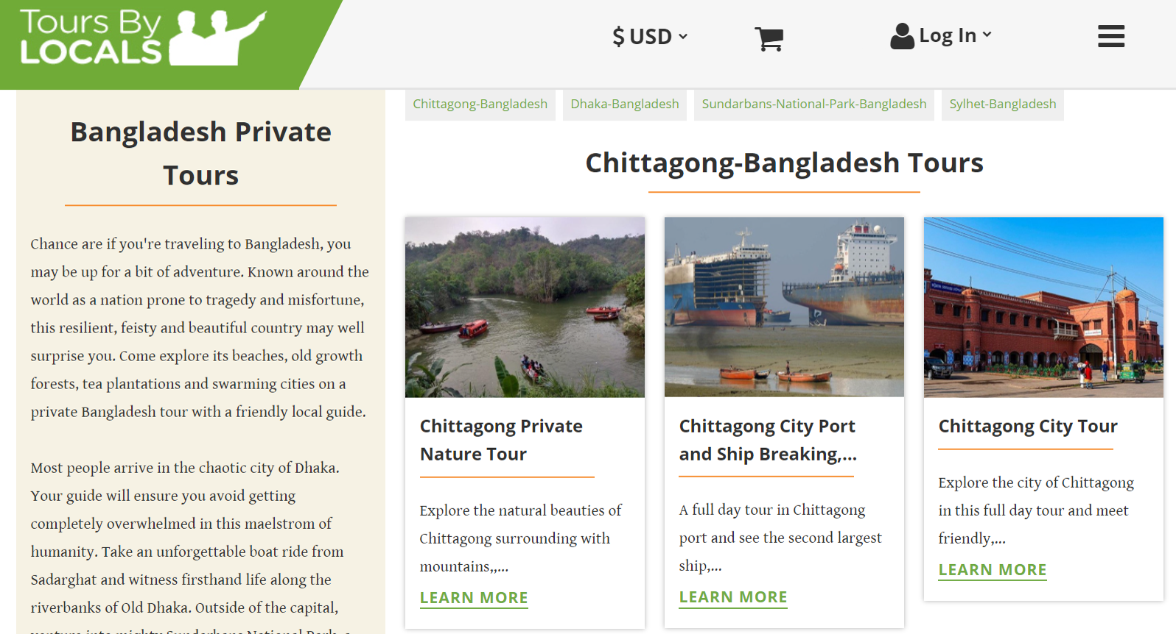

Slide 13
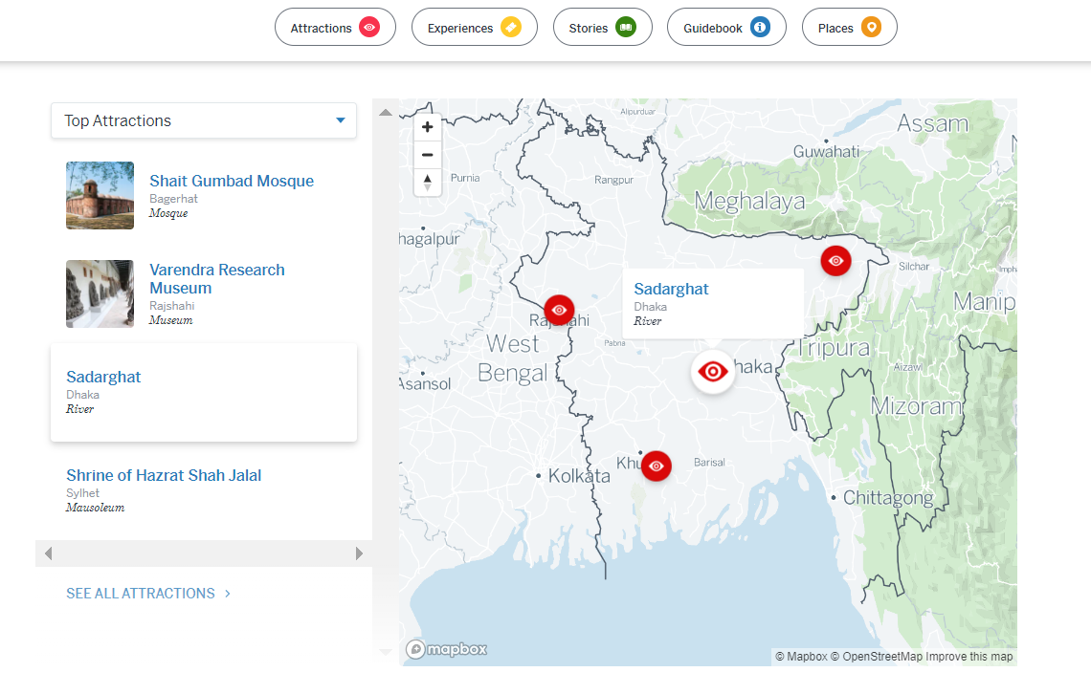
LonelyPlanet

Slide 14
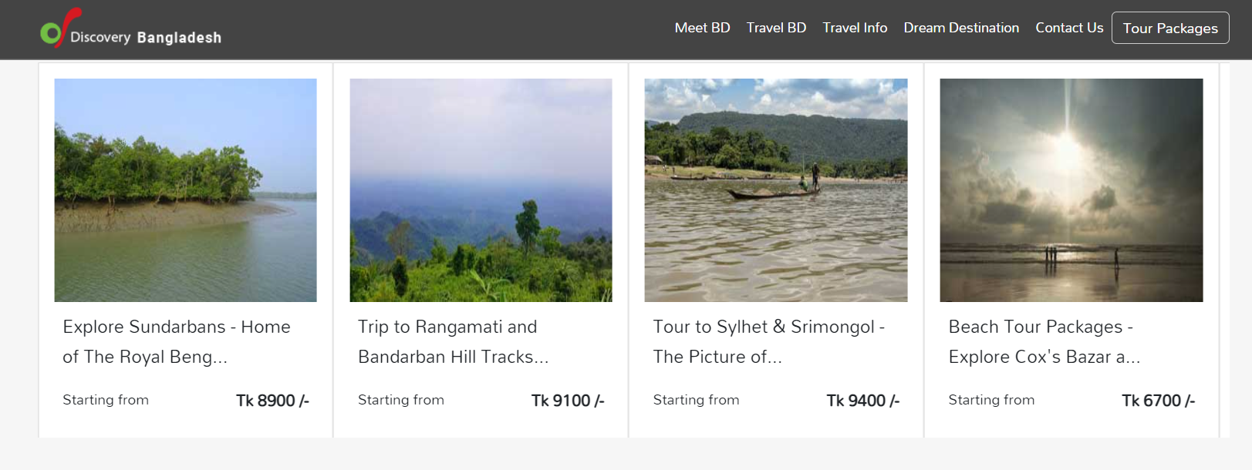

Slide 15
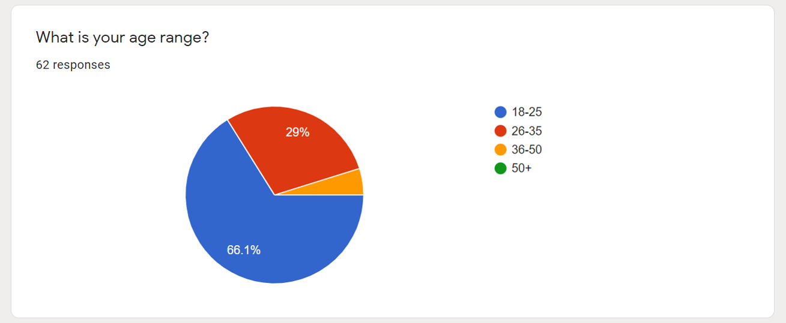

Slide 16
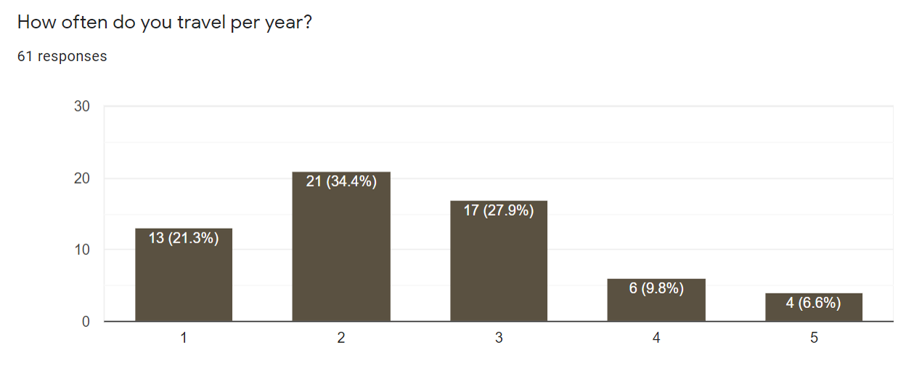

Slide 17
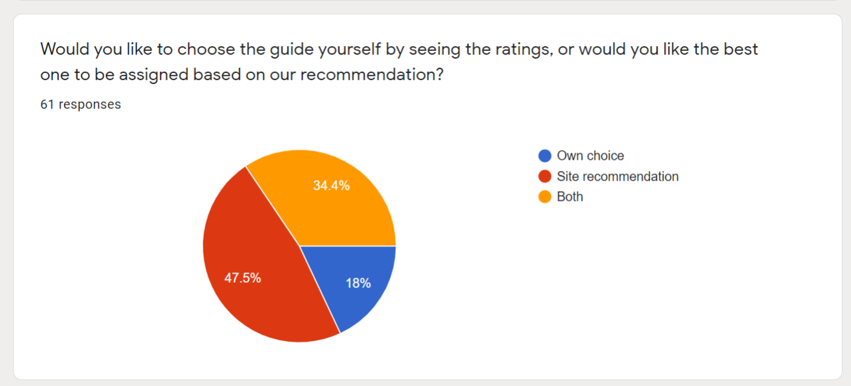

Slide 18
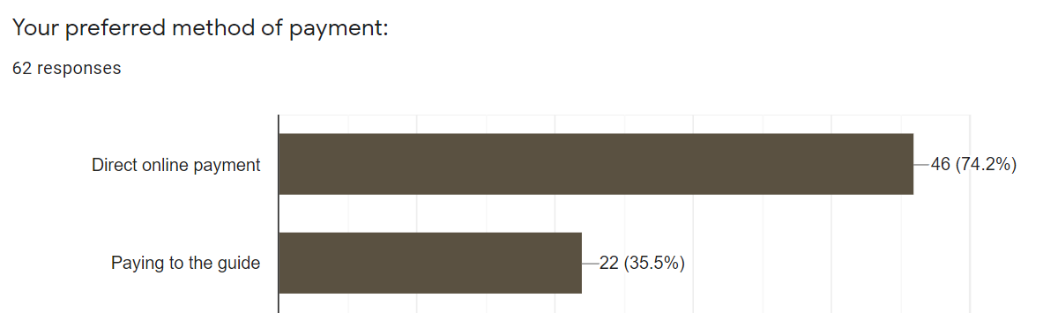

Slide 19
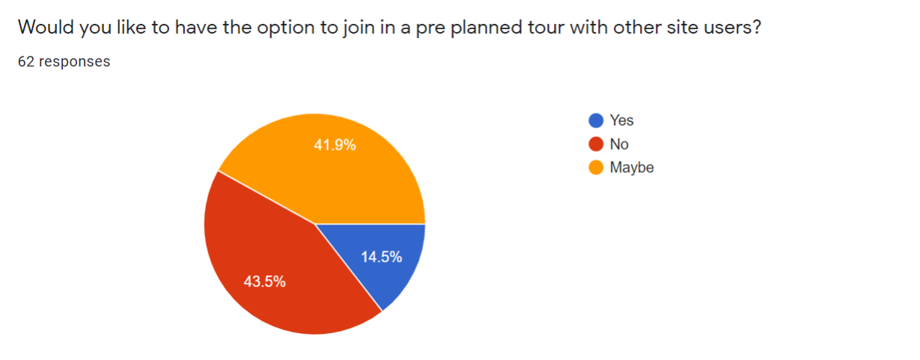

Slide 20
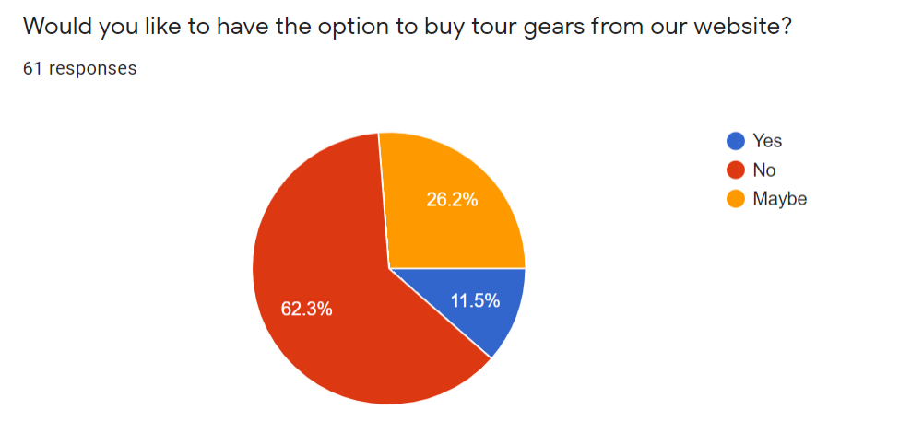

Slide 21
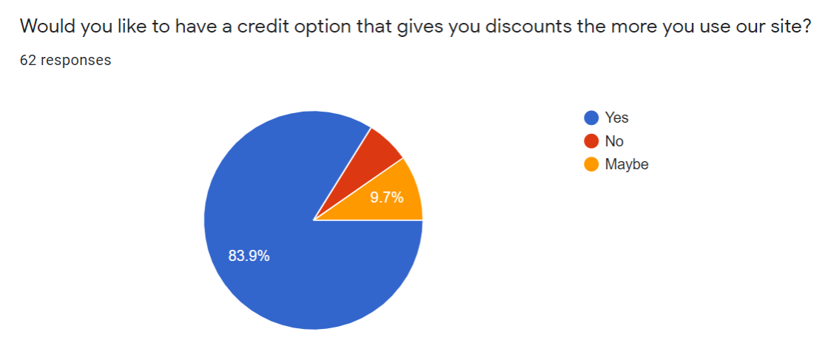

Slide 22
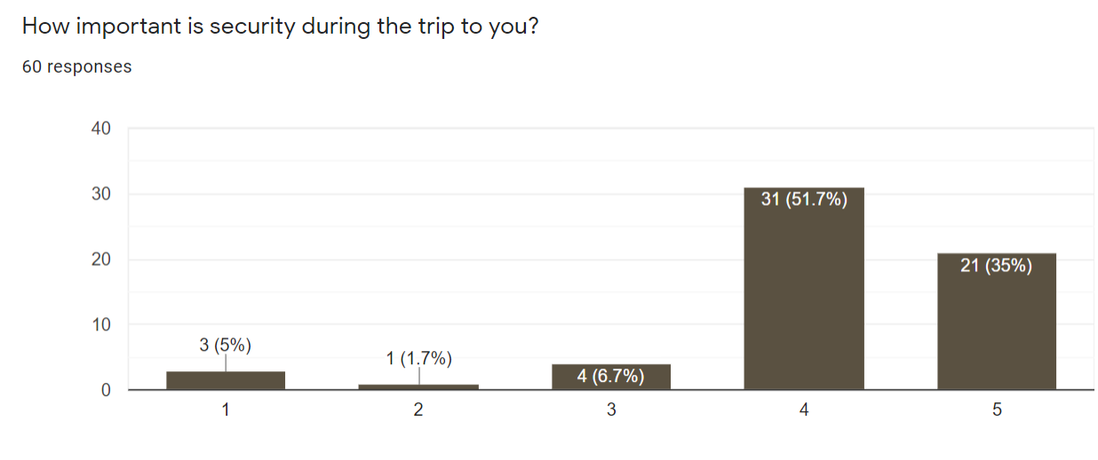

Slide 23
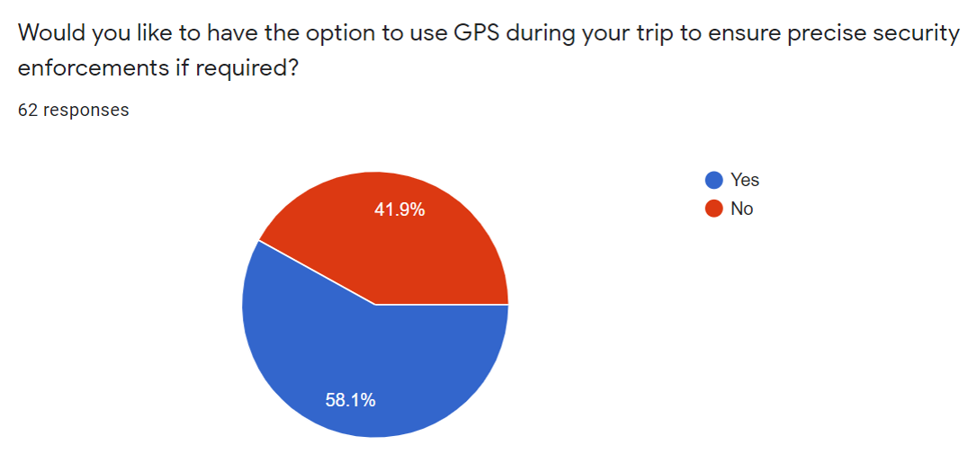

Slide 24
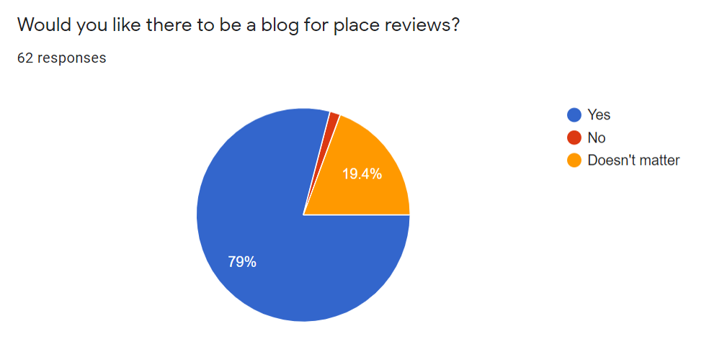

Slide 25
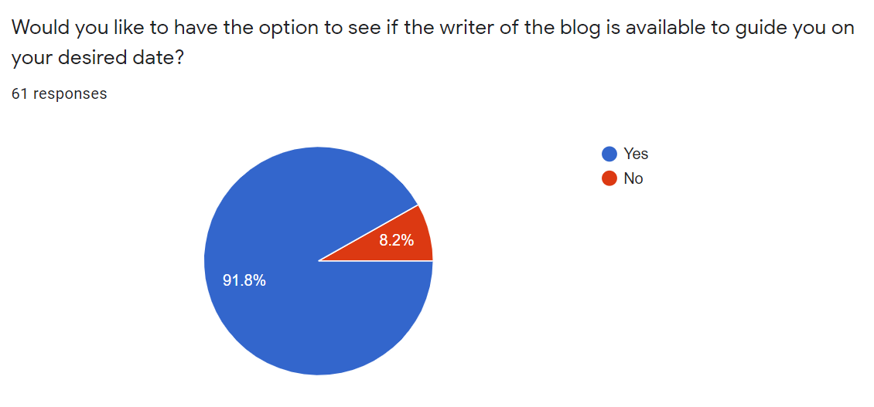

Slide 26
Requirements Specification
Responsive automated website
Location API
Payment gateway
Funding, Manpower

Slide 27

Thank You

